Slide 1
GSKY Developer Guide
A distributed geospatial data server exposing OGC services
Copyright © 2018 by National Computational Infrastructure, Canberra, ACT, Australia.
7 December, 2018

Slide 2
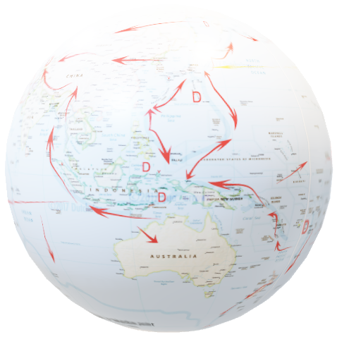
Using GSKY through TerriaMap
NATIONAL MAP
“TerriaJS was born late 2014 thanks to NationalMap. It started as a web based platform. The Australian NationalMap platform contributed greatly in opening data by government agencies and in discovering and consuming open data by general public, industry, academia and the government itself. NationalMap is managed and maintained by: Digital Transformation Agency - product ownership, Geoscience Australia - product hosting, Data61 Terria - product software development.”^{[Ref]}
Next slide is a non-technical user guide, similar to GSKY_User_Guide.pptx.
Three slides that follow it will show the process with code snippets.
See GSKY_OWS_Server.docx for details.
It will take approximately 10 minutes to watch this animation.
Use GSKY_Developer_Guide.pptx for controlled slideshow at your own pace.
DISCLAIMER
Some of the relevant code snippets from TerriaMap (TerriaJS-specs.js) and GSKY (ows.go) are shown. They give pointers to understand the programs by studying the full code. It is out of scope of this demo to include all code. More details are given in the above Word document. Gaps exist in code descriptions and the information may change over time.
The slide show will begin in 5 seconds !
2

Slide 3
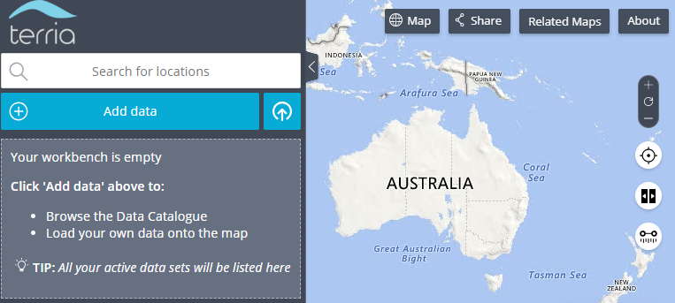
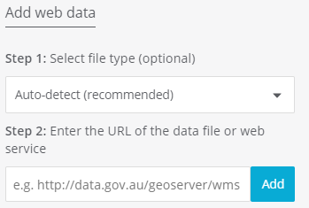
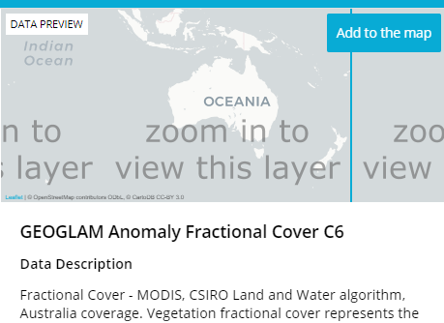
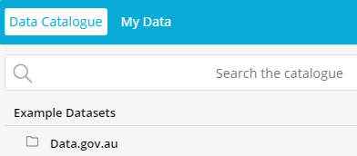
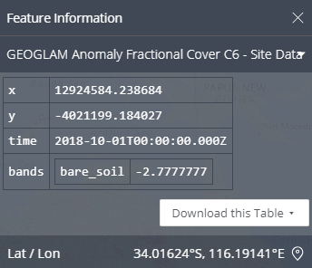
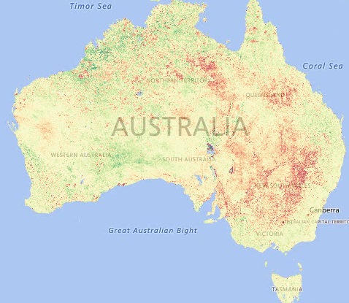
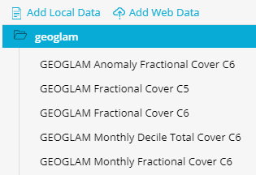
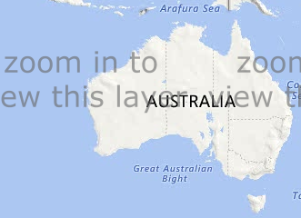
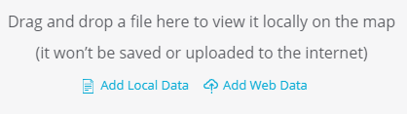
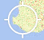

GSKY/TerriaMap User Guide
This animation will demonstrate the use of GSKY through TerriaMap, using the GEOGLAM data. There are more layers than those shown here, but not all may have displayable data. In some cases you will have to zoom in to see any overlaid data.
Add to the map
Add data
My Data
http://130.56.242.15/ows/geoglam
Add
GEOGLAM Anomaly Fractional Cover C6
Add Web Data
Next: Technical Details
1. Click: Add data
5. Click: A layer name
2. Click: My data
6. Click: Add to the map
3. Click: Add Web Data
7. Zoom: Use the mouse wheel
3
4. Type: Address of GSKY server. Click: Add
8. Click: On any pixel on the map

Slide 4
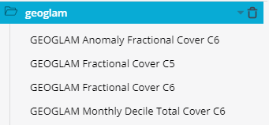
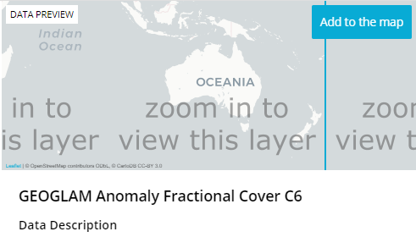
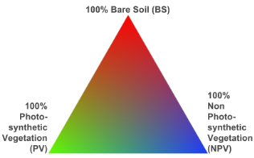
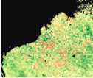
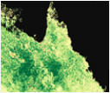


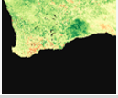
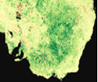
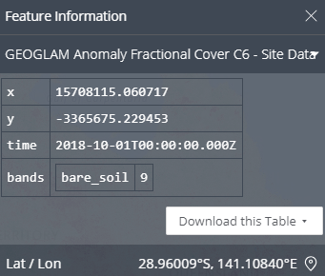
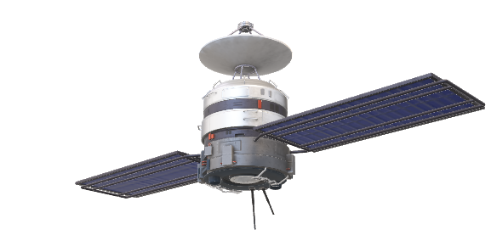
GSKY/TerriaMap Technical Communication
This is an overview of the calls from TerriaMap to GSKY and back. TerriaMap client calls the GSKY server to get the relevant information and displays them over the map. There are five request-types, viz. GetCapabilities, DescribeLayer, GetLegendGraphic, GetMap and GetFeatureInfo which are called sequentially. This animation shows the back and forth communication. The next two slides will show the code snippets in detail.
XML:WMS_GetCapabilities.tpl
Service: Name, Title, Abstract, Keywords, ContactInformation
Capability: DCPType, FeatureInfo, Exception
Layers: Title, Abstract, Bbox, CRS, Times, MetadataURL, DataURL
WMS_DescribeLayer.tpl <WMS_DescribeLayerResponse version="1.1.1">
<LayerDescription name="global:c6:monthly_anom_frac_cover" owsURL="http://130.56.242.15/ows/geoglam" owsType="WMS">
<Query typeName="global:c6:monthly_anom_frac_cover"/>
</LayerDescription>
</WMS_DescribeLayerResponse>
WMS_ServiceException.tpl <ServiceExceptionReport version="1.1.1" >
<ServiceException code="LayerNotDefined" locator="MapLayerInfoKvpParser">{{ . }} no such layer on this server.</ServiceException>
</ServiceExceptionReport>
case "GetMap": &proc.GeoTileRequest{ConfigPayLoad: proc.ConfigPayLoad{… proc.NewTileIndexer(ctx, conf.ServiceConfig.MASAddress, errChan) go indexer.Run(*verbose) proc.InitTilePipeline(…) tp.Process(geoReq, *verbose): tils.EncodePNG(norm, styleLayer.Palette) w.Write(out)
GetCapabilities
DescribeLayer
GetLegendGraphic
GSKY
GetMap
Next: Process flow at code level
case "GetFeatureInfo":
type:FeatureCollection
Properties: x, y, time, feat_info
GetFeatureInfo
4

Slide 5
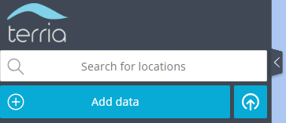
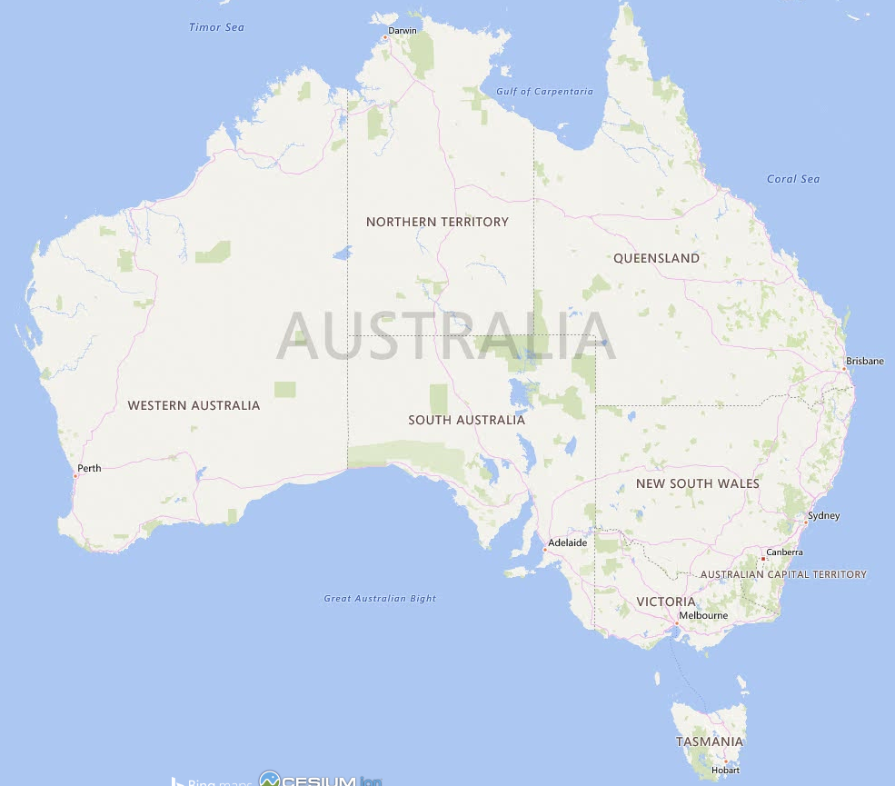
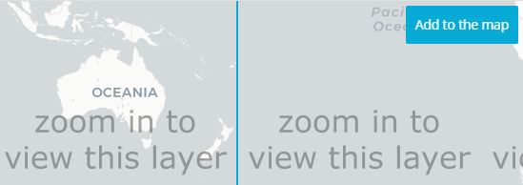

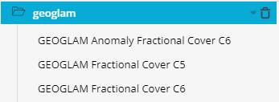

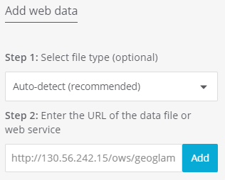

GSKY/TerriaMap Code Interactions
Geo-spatial data stored in GSKY database can be layered over a world map. On the next two slides the steps and code snippets are shown to demonstrate the usage and inner workings.
Add to the map
Add data
My Data
/TerriaMap/build/TerriaJS/build/TerriaJS-specs.js:44667:
return cleanUrl(this.url) + '?service=WMS&version=1.3.0&request=GetCapabilities';
GEOGLAM Anomaly Fractional Cover C6
Add Web Data
http://130.56.242.15/ows/geoglam?service=WMS&request=GetCapabilities&version=1.3.0&tiled=true
gopath/src/github.com/nci/gsky/ows.go:179: case GetCapabilities:
utils.ExecuteWriteTemplateFile(w, conf, utils.DataDir+"/templates/WMS_GetCapabilities.tpl")
/TerriaMap/build/TerriaJS/build/TerriaJS-specs.js:44818:
layerTitles: {
get: function get() {
return this._allLayersInRawMetadata.map(function (layer) {
return layer.Title || layer.Name;
});
}
}
Next Slide
Add

Slide 6
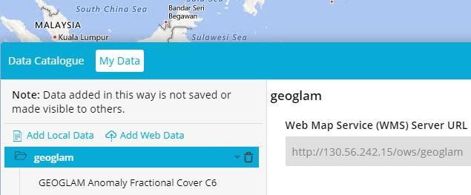
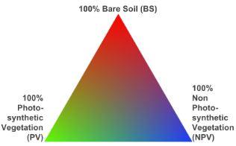
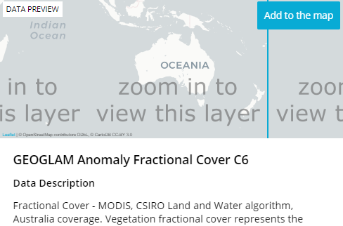
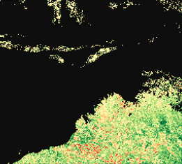
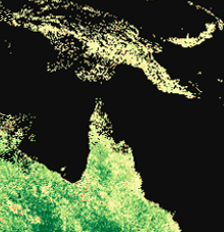
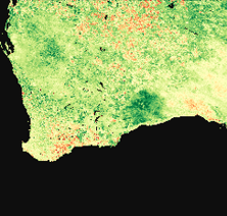
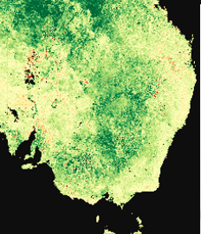

GSKY/TerriaMap Code Interactions
TerriaMap includes a Node.JS-based webserver that can connect to various data sources that comply with WMS and WPS formats. It can send requests to the GSKY server and display the returned results. This slide will show an overview of the process flow. Code snippets from both TerriaMap and GSKY are shown.
/TerriaMap/build/TerriaJS/build/TerriaJS-specs.js:45977:
legendUri = new URI(cleanUrl(catalogItem.url) + '?service=WMS&version=1.1.0&request=GetLegendGraphic&format=image/png&transparent=True&layer=' + encodeURIComponent(thisLayer.Name));
http://130.56.242.15/ows/geoglam?service=WMS&version=1.1.0&request=GetLegendGraphic&format=image%2Fpng&transparent=True&layer=global%3Ac6%3Amonthly_anom_frac_cover&srs=EPSG%3A3857
/TerriaMap/build/TerriaJS/build/TerriaJS-specs.js:45449:
return new WebMapServiceImageryProvider({
url: cleanAndProxyUrl(this, this.url),
layers: this.layers,
getFeatureInfoFormats: this.getFeatureInfoFormats,
parameters: parameters,
getFeatureInfoParameters: parameters,
tilingScheme: defined(this.tilingScheme) ? this.tilingScheme : new WebMercatorTilingScheme(),
maximumLevel: maximumLevel
});
/TerriaMap/build/TerriaJS/build/TerriaJS-specs.js:45298:
var describeLayersURL = cleanUrl(that.url) + '?service=WMS&version=1.1.1&sld_version=1.1.0&request=DescribeLayer&layers=' + encodeURIComponent(that.layers);
http://130.56.242.15/ows/geoglam?time=2001-01-01T00%3A00%3A00.000Z&srs=EPSG%3A3857&transparent=true&format=image%2Fpng&exceptions=application%2Fvnd.ogc.se_xml&styles=&tiled=true&feature_count=101&service=WMS&version=1.1.1&request=GetMap&layers=global%3Ac6%3Amonthly_anom_frac_cover&bbox=15028131.257091936%2C-5009377.085697312%2C17532819.79994059%2C-2504688.542848654&width=256&height=256
http://130.56.242.15/ows/geoglam?time=2001-01-01T00%3A00%3A00.000Z&srs=EPSG%3A3857&transparent=true&format=image%2Fpng&exceptions=application%2Fvnd.ogc.se_xml&styles=&tiled=true&feature_count=101&service=WMS&version=1.1.1&request=GetMap&layers=global%3Ac6%3Amonthly_anom_frac_cover&bbox=15028131.257091936%2C-2504688.542848654%2C17532819.79994059%2C0&width=256&height=256
http://130.56.242.15/ows/geoglam?time=2001-01-01T00%3A00%3A00.000Z&srs=EPSG%3A3857&transparent=true&format=image%2Fpng&exceptions=application%2Fvnd.ogc.se_xml&styles=&tiled=true&feature_count=101&service=WMS&version=1.1.1&request=GetMap&layers=global%3Ac6%3Amonthly_anom_frac_cover&bbox=12523442.714243278%2C-2504688.542848654%2C15028131.257091936%2C0&width=256&height=256
http://130.56.242.15/ows/geoglam?service=WMS&version=1.1.1&sld_version=1.1.0&request=DescribeLayer&layers=global%3Ac6%3Amonthly_anom_frac_cover
http://130.56.242.15/ows/geoglam?time=2001-01-01T00%3A00%3A00.000Z&srs=EPSG%3A3857&transparent=true&format=image%2Fpng&exceptions=application%2Fvnd.ogc.se_xml&styles=&tiled=true&feature_count=101&service=WMS&version=1.1.1&request=GetMap&layers=global%3Ac6%3Amonthly_anom_frac_cover&bbox=15028131.257091936%2C-5009377.085697312%2C17532819.79994059%2C-2504688.542848654&width=256&height=256
gopath/src/github.com/nci/gsky/ows.go:206:
case DescribeLayer:
utils.ExecuteWriteTemplateFile(w, conf.Layers[idx], utils.DataDir+"/templates/WMS_DescribeLayer.tpl")
gopath/src/github.com/nci/gsky/ows.go:220::
case GetMap:
proc.InitTilePipeline(ctx, conf.ServiceConfig.MASAddress, conf.ServiceConfig.WorkerNodes, conf.Layers[idx].MaxGrpcRecvMsgSize, conf.Layers[idx].WmsPolygonShardConcLimit, conf.ServiceConfig.MaxGrpcBufferSize, errChan)
out, err := utils.EncodePNG(norm, styleLayer.Palette)
w.Write(out)
End of the slide show !
6

Slide 7






Acknowledgements

